Slide 1

Twitter Sentiment app Part -2

Slide 2
So, what do we have so far….
We built some helpful function to make the connection with the twitter API and further, we were able to get a function to plot the results of the sentiment using the textblob library.

Slide 3
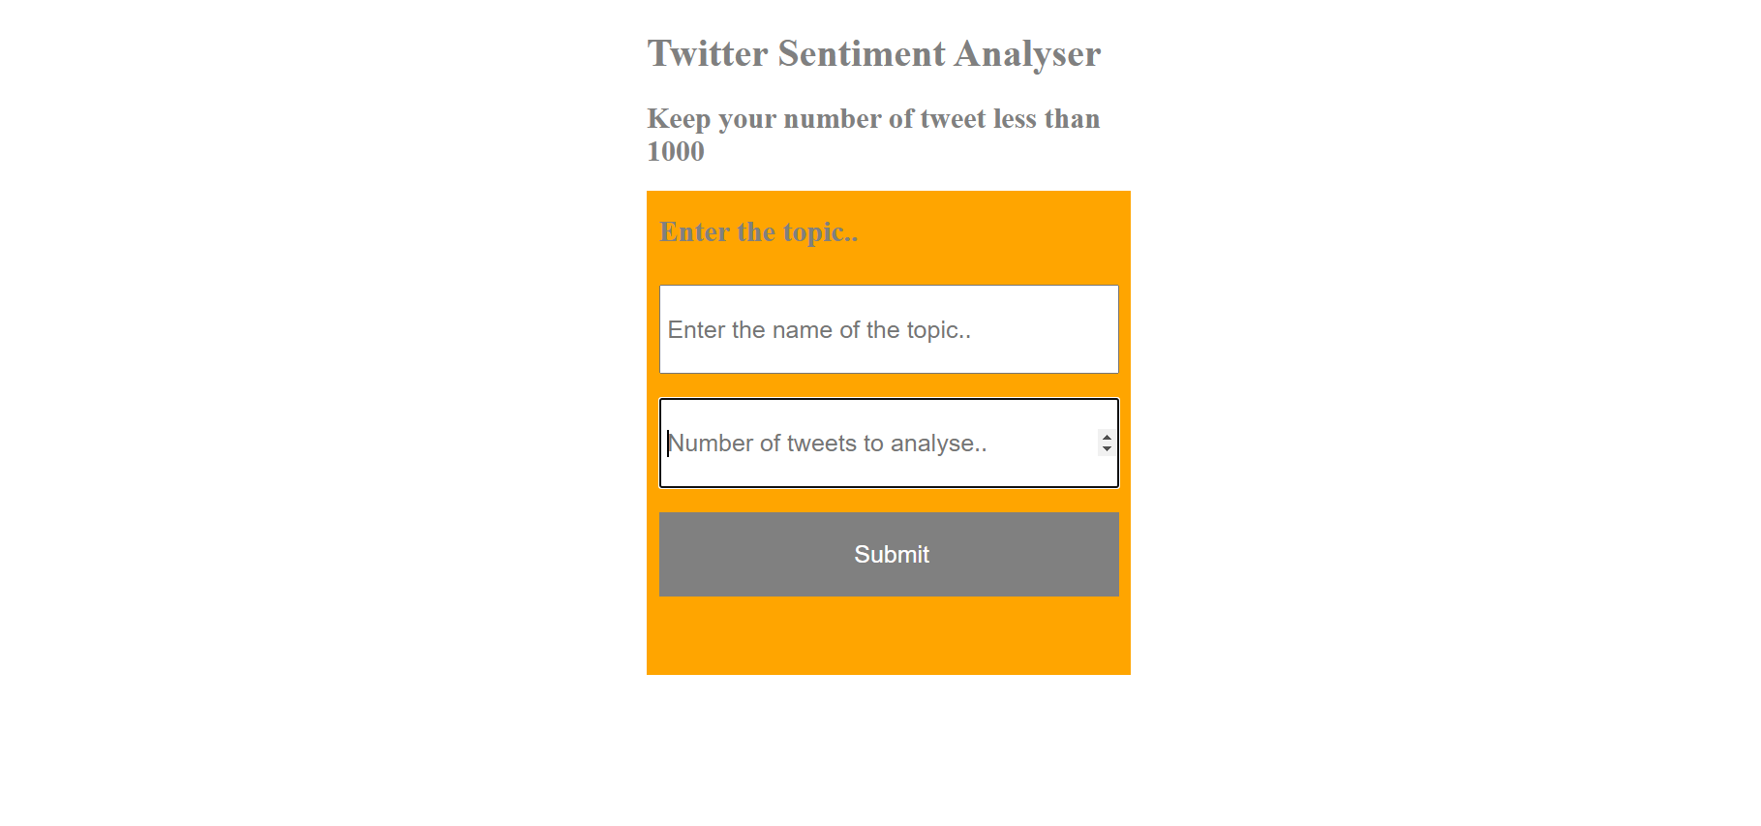
What we were building?

Slide 4
So, how are we going to build that application...
The application that you just saw is a really big application (although it looks small). There are many small pieces attached to this app which we need to first understand before we actually can start building that app. This is why, we will building this application one by one. In this video, we will be learning about the backend and in the next video, we will build the frontend part. So, let us get started.

Slide 5
Agenda for this video… (App Without any style )
Create a templates folder in the project directory
Create a file called index.html
Create a file called display.html
Create a new folder for static content which also holds a folder named images
Initialize a new app with the static_url_path = “/static” (This is important)
Set up the route (“/”) with GET and POST methods
If method == post, then display the desired html page (display.html with an image). But before that, call the functions that we created in the last class to display the image. Save the image in the images folder so that the html page can pick it up on submit.
Otherwise display an index.html page with two inputs and submit button.

Slide 6
Add Style to the APP
Style for the index page:
Add the background color of orange
Change the display position of form element to flex
Change the flex direction property
Set the fixed width to the form and set margin to auto so that app comes to the center.
Change the font size
Change the color of the button.
Change the Header color and button background color
Change the button background on hover.

Slide 7
Add Style to the APP (Continued)
Style for the index page:
There is not much to do. Most of the things are there in the image.
Change the color of the text
Change the width and margin to auto
So,that the display screen comes to the center of the browser screen
And we are done..

Slide 8
Thank you

